Slide 1
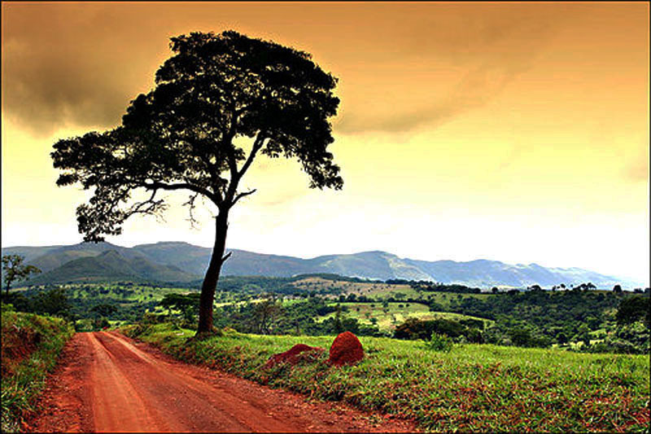
Why do we need dialogue about population & consumption?
NCC Seminar – Sydney – 21 Nov 2015
Professor Stuart B. Hill
Western Sydney University
s.hill@westernsydney.edu.au
www.stuartbhill.com
Notes:
1

Slide 2
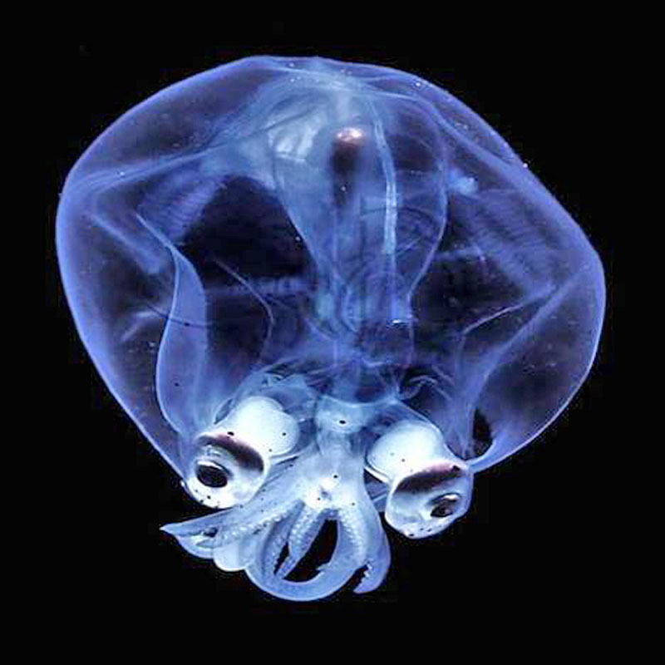
Assumptions: ‘You & Me’ (& our species)
we are truly amazing beings; our species has learned a
phenomenal amount through its experiences; & yet…
we have hardly scratched the surface of our potential
consequently, opportunities for improvement & progress
  are enormous – remember this when feeling hopeless! – HOWEVER, this will involve overcoming fear, denial & postponement, & having the courage to heal our hurts, collaborate across difference, & act on love from our core being
Notes:
2

Slide 3
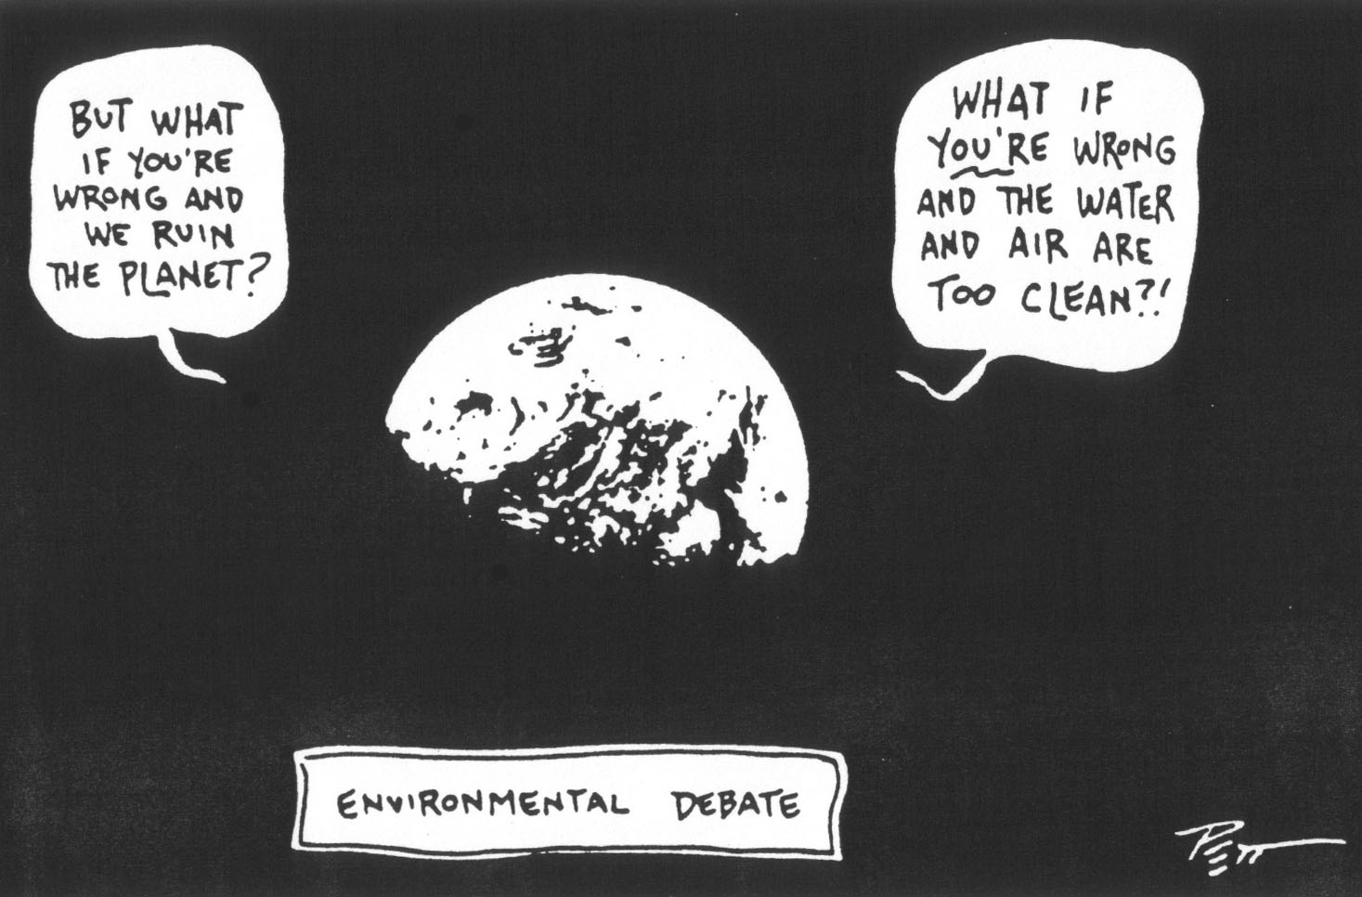
Planet
exhaustion of fossil fuel reserves & other non-renewable resources
global warming, associated climatic changes & rising sea level
thinning of ozone layer & accumulation of ‘waste matter' in space
fluctuating water tables, drought, drying lakes & rivers, & flooding
contamination of soil, water & organisms with pollutants
deforestation, desertification, soil erosion & land degradation
loss of habitat, biodiversity, species, varieties & cultivars
Notes:
3
3

Slide 4
A ‘life-enabling’ triple bottom line
(not privileging economics, & including the personal)
Planet, environment, ecological systems, nature, & all of life (have absolute requirements)
Socio-cultural: institutional structures &
processes in politics, economics, business,
education, technology, religion…
People: communities, groups, families,
individuals (you & me!)
Notes:
4

Slide 5
Ecologists studying other animal species
ask primarily 4 questions:
  How many are there? - 'numbers'
  How are they distributed? - 'distribution'
  What are they doing? - 'activities'
  What are their relationships with the 'environment‘?
Thus, to be responsible we must ask of ourselves:
  How many is optimum?
  How should & shouldn’t we distribute ourselves?
  What should & shouldn’t we do?
  How should & shouldn’t we relate to & interact with the environment ( taking into account its ‘carrying capacity’) & with one another?
Notes:
5

Slide 6
If any species (including our own) has:
  high numbers
  highly aggregated distribution
  (located away from the resources it needs)
  highly consumptive lifestyle
then it will:
  need & will consume lots of resources
  have a high impact on the environment
& so, will eventually become unsustainable
the time taken to experience this will be shorter
the lower the environment’s ‘carrying capacity’
Notes:
6

Slide 7
Key ecological things to consider
If our species has:
  low numbers
  is distributed close to the resources it needs
  has a conserver lifestyle/activities
  lives in an environment with high ‘carrying capacity’, which it builds up & maintains
  (biodiversity & bio-ecological processes)
  & if we act on loving vs. fearing one another
then we should be able to live sustainably
Notes:
7

Slide 8
Population activities (incl. relationships)
Resource need & use
Environmental impact
Population numbers
Population distribution
Sustainable Unsustainable
Notes:
8

Slide 9
Known & unknown/unseen
What is unknown
Engaged with through our
experience, intuition
& wisdom
What is known
The focus of our cleverness
The challenge: how to engage clearly with the unknown & mystical
André Voisin, 1959. Soil, Grass and Cancer. Longmans, London
Notes:
9

Slide 10
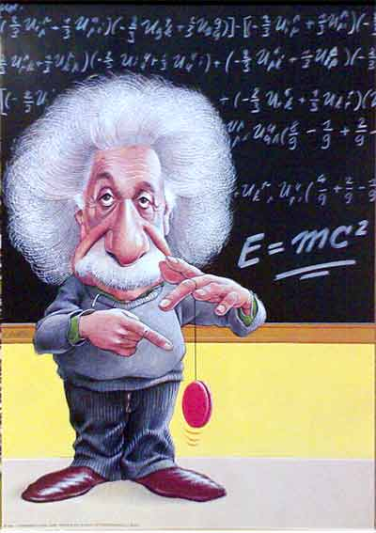
Clever people know how
to solve problems
Wise people avoid them!
Attributed to Albert Einstein
Notes:
10

Slide 11
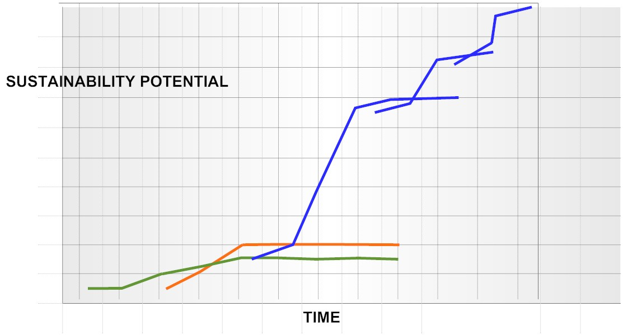
Unrealised potential of design/redesign
etc.
3
2
1
REDESIGN
(proactive)
SUBSTITUTION
EFFICIENCY
(both primarily reactive)
Notes:
11
11

Slide 12
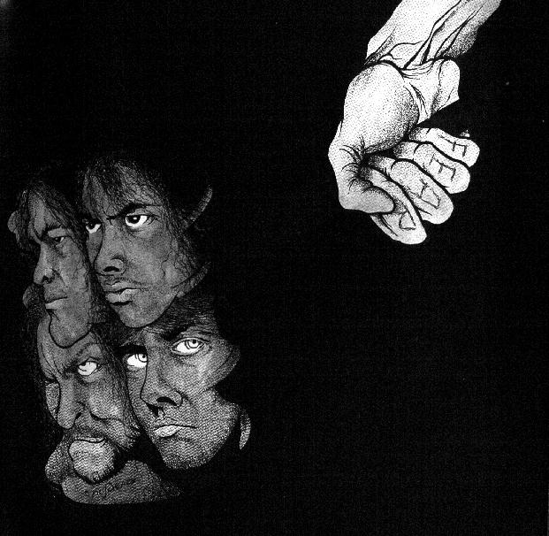
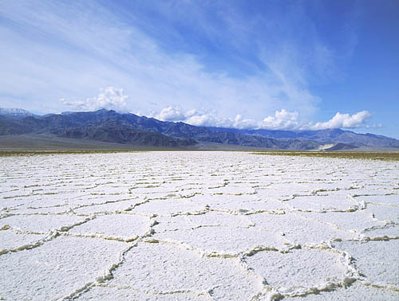
Failure to redesign & maintain systems is resulting in: personal, social & environmental degradation
We urgently need to learn:
– particularly from psychology & ecology –
how to better live more caring, sustainable
& genuinely meaningful healthy lives
Notes:
12
12

Slide 13
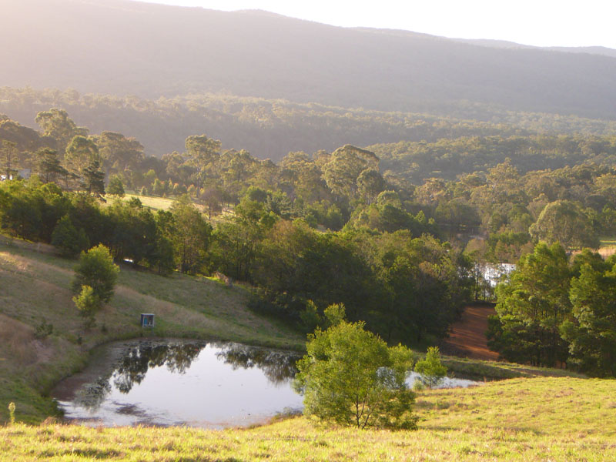
Rewards to all natural resource managers;
re production, maintenance & sustainability
Productivity
yield, output
Erodes natural capital
& ecological integrity
(declining productivity)
Rehabilitation &
maintenance
Builds natural capital,
ecological integrity
(basis for sustained productivity)
Notes:
13

Slide 14
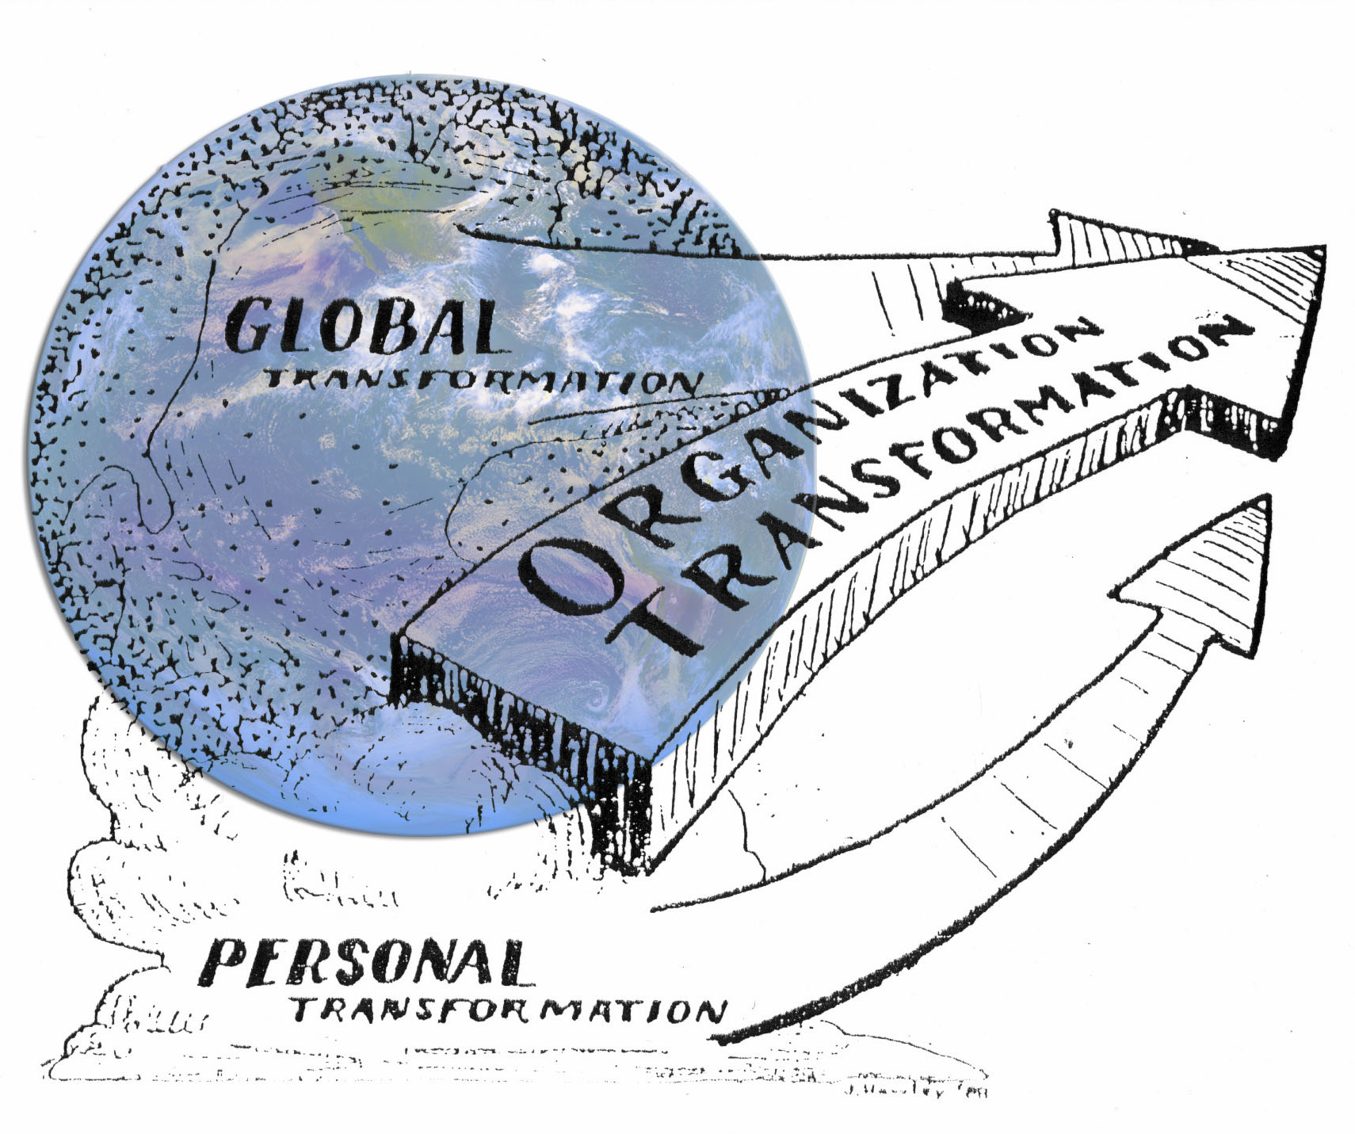
Parallel interrelated change processes
What meaningful do-able initiatives can we take in each
of these areas to support ‘progressive’ cultural change?
Notes:
14

Slide 15


Establishment of compensatory selves
(maladapted & in denial)
hurt, oppression (this has happened to ALL of us!)
adaptation (maladaptation)
core ‘healthy’ self/essence
Core
‘healthy’
spontaneous
in present
aware
empowered
loving
informed action
Maladaptive compensatory
patterned
in past/future
unaware
disempowered
fearful
acting-out/postponing
repeated & new hurts & oppressions
multiple selves
distorted potentially ‘healthy’ behaviour
superimposed ‘unhealthy’ behaviour
Notes:
15

Slide 16
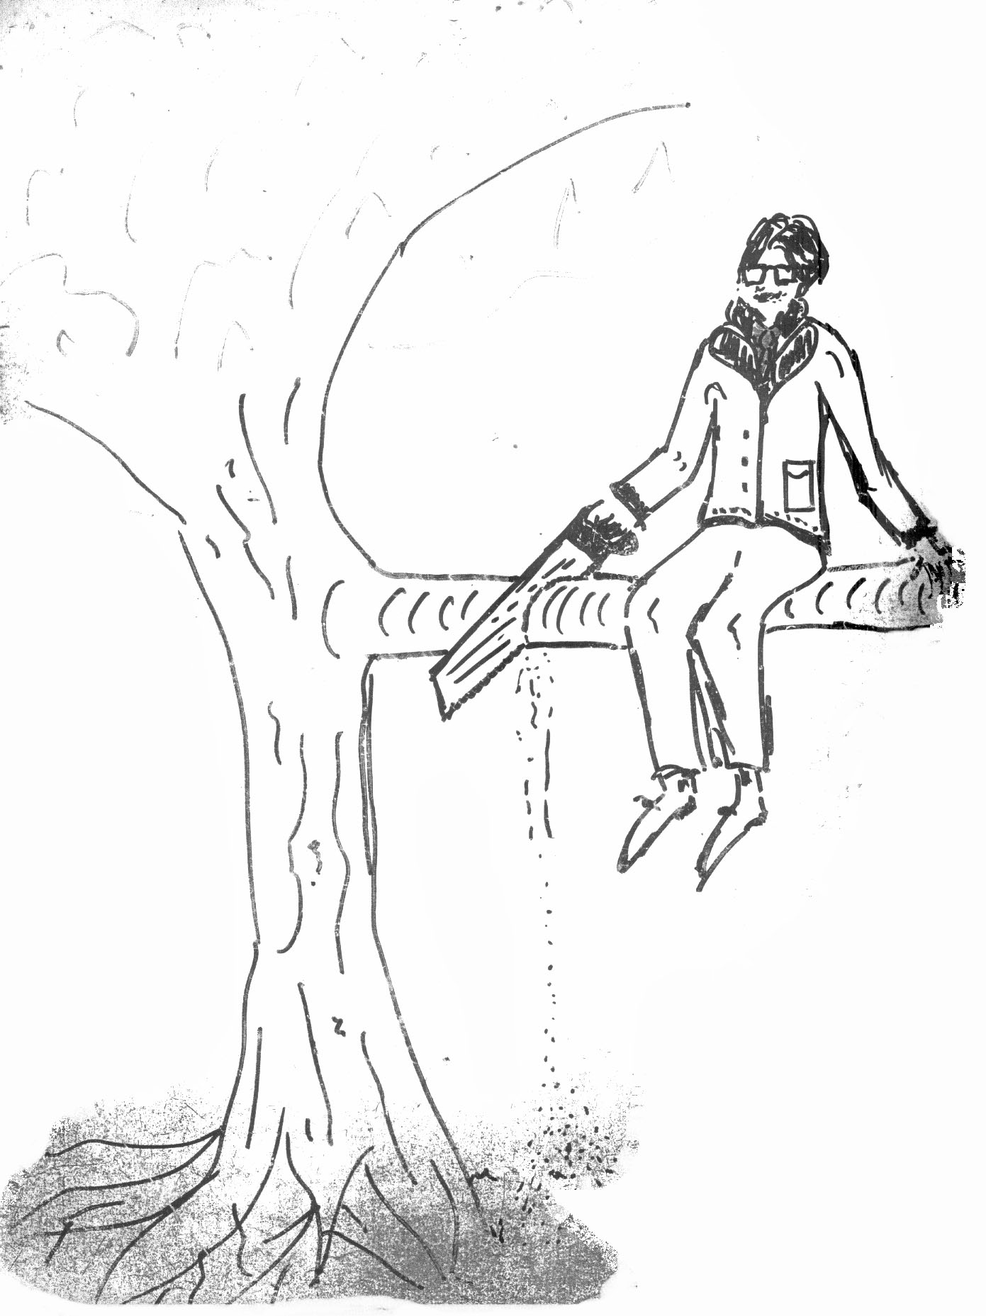
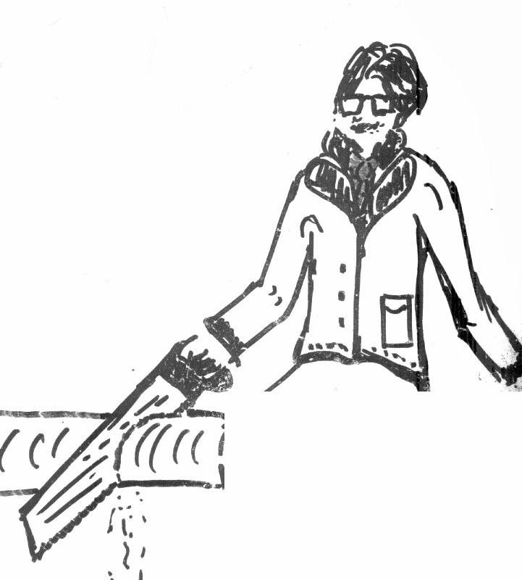

Slide 17
Person (genetics plus)
Understandings, Values, Morals, & Ethics
Past Environments/Experiences
Actions
Present Environment/Conditions
Supportive Oppressive
Notes:
17

Slide 18
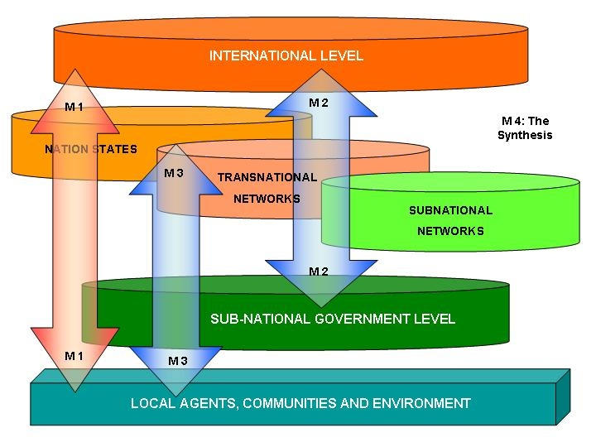
Limiting factors for change
(the most commonly mentioned barriers)
information & access to it, misinformation,
knowledge, skills, competencies…
resources: renewable, non-renewable, technologies, money, time…
institutional supports: policies, programs, structures, services, legislation, regulations…
Notes:
18

Slide 19
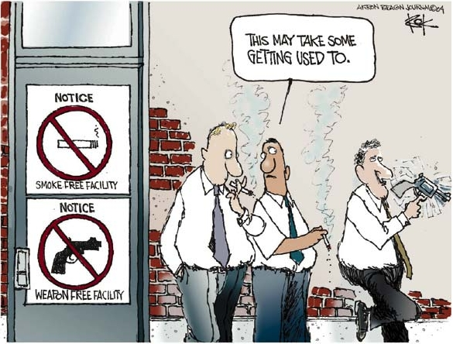
Limiting factors for change
(usually the more important barriers)
family & community support
empowerment/disempowerment
(feelings of helplessness/hopelessness)
awareness
vision & imagination
values, worldviews, paradigms, beliefs
persistent denial, procrastination & distractive/compensatory activities
Notes:
19

Slide 20
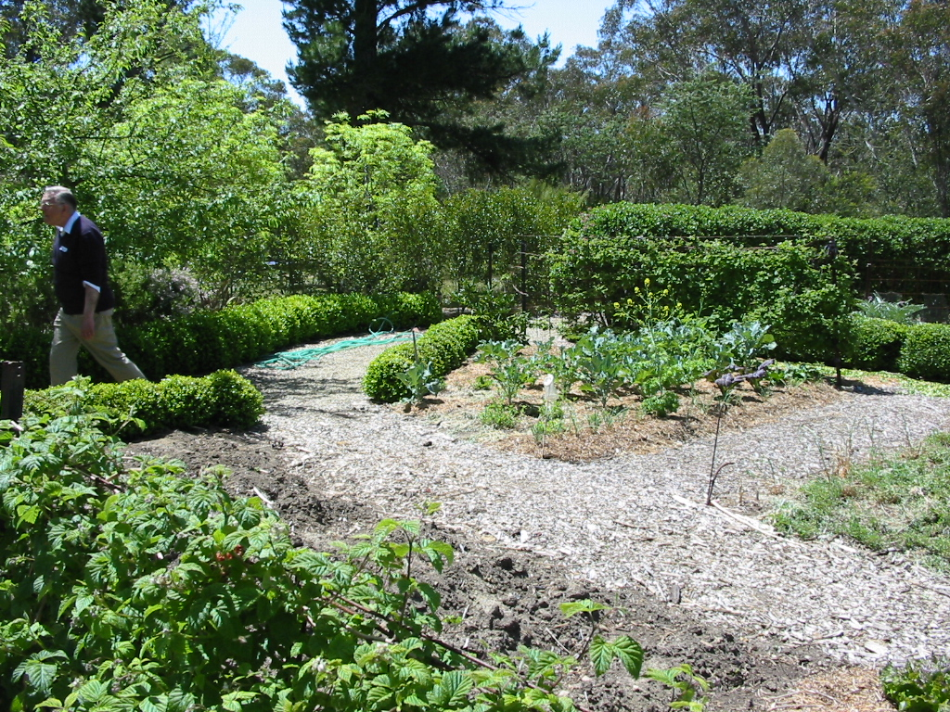
5 decisions to make re any change
  what to stop doing
  what to reduce/de-emphasise
  what to do differently
  what to increase/expand
  what to start doing (new)
Notes:
20

Slide 21

5 overlapping stages in change (Hill 2005)
ignorance & denial (in any area: climate...)
awareness & acknowledgement
gaining some understanding & competence
effective action & project-based initiatives
ongoing co-evolution of responsible
life-affirming practices (how we now live)
Notes:
21

Slide 22
