Slide 1
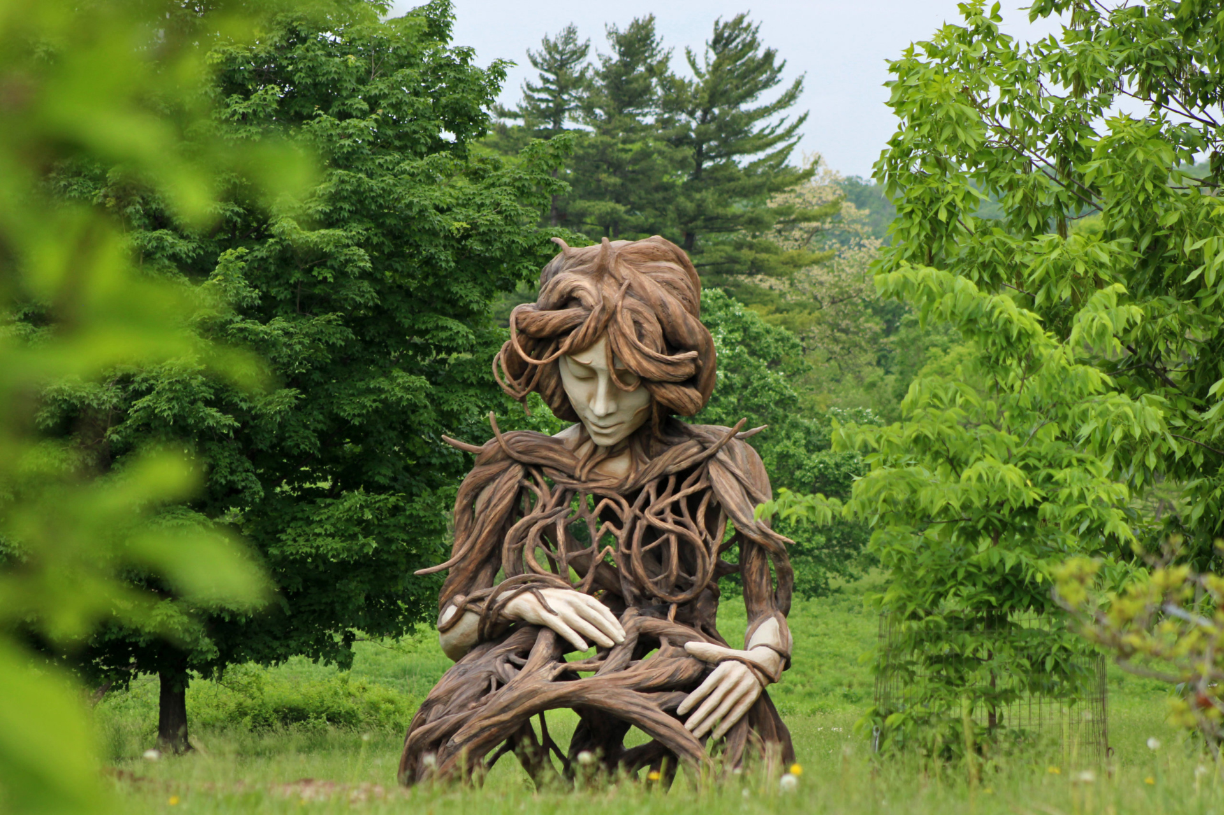
Agricultural Sustainability
Ecological & Psycho-social Foundations
Emeritus Professor Stuart B Hill, Western Sydney University
s.hill@westernsydney.edu.au https://stuartbhill.com/

Slide 2
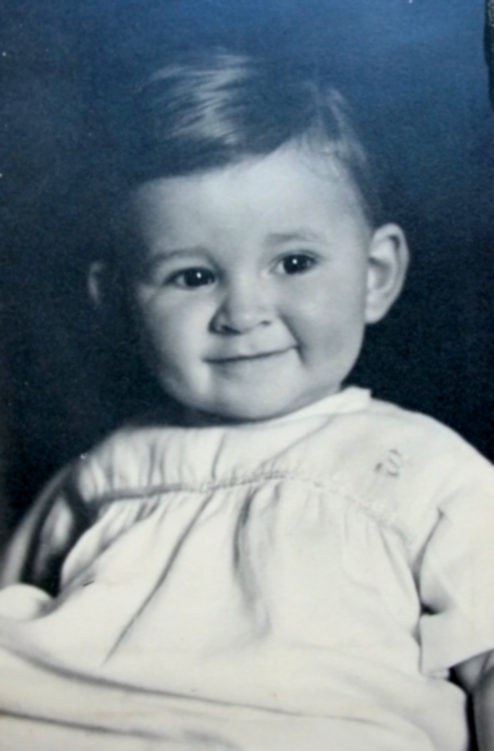
Me as a baby
Ecology: 1st whole ecosystem study by individual (1960s)
Soil & Sust Ag: taught Ecol Ag & Soil Animal Ecol at McGill (1969-95/1986)
Sustainable Agriculture: est. Ecological Agriculture Projects (McGill 1974)
Organised & edited proceedings of 1st Int. Conf. on Organic Farming (Montreal 1978)
Psychotherapy: single-sessions; clients: politicians & a royal fam.
Publications: 300+ papers & 4 books
1st publication on psychology of Sust Ag (1991)

Slide 3
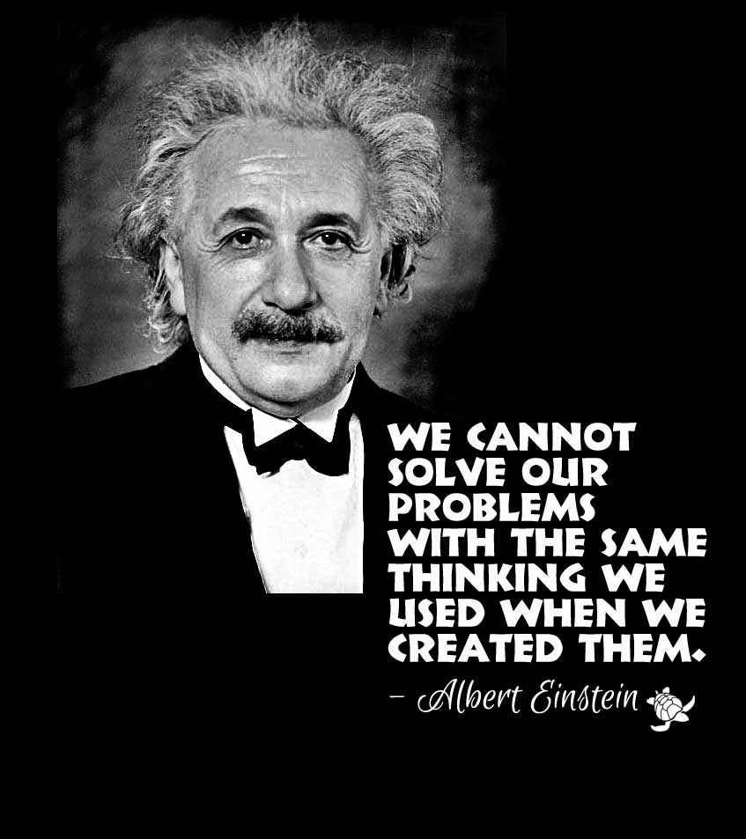
Prerequisites for effective action re genuine progress
Understanding systems, holism & complex relationships
(between ecology, psychology, our psycho-social evolution…)
Being willing & able to look broadly & deeply (to see what is missing in current structures, practices & responses to problems & visions of futures)
Courage to name these & raise possible alternatives
Notes:
3

Slide 4
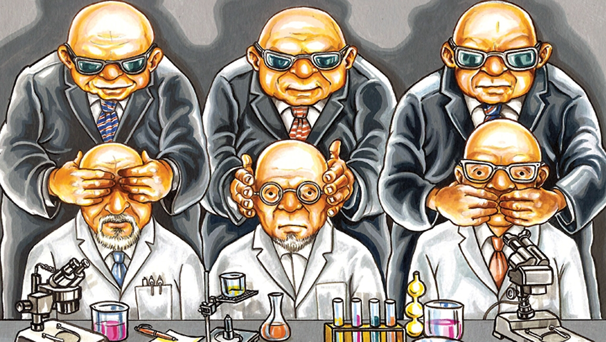
Developing communication & enabling change skills to do this effectively
Do personal recovery work, seek mentoring & continue learning (to enable above)
Get peer support, create networks & enable ideas & initiatives to spread
Notes:
4

Slide 5
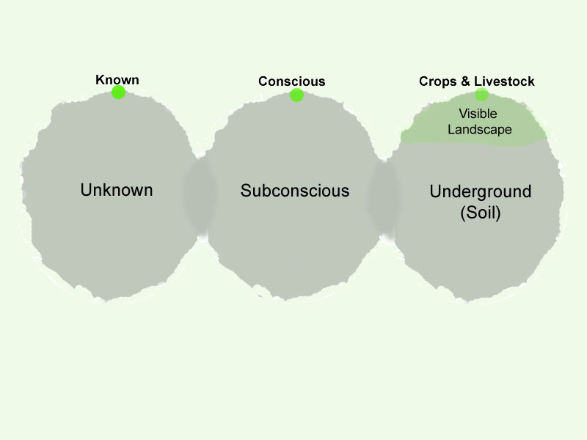
Notes:
5

Slide 6
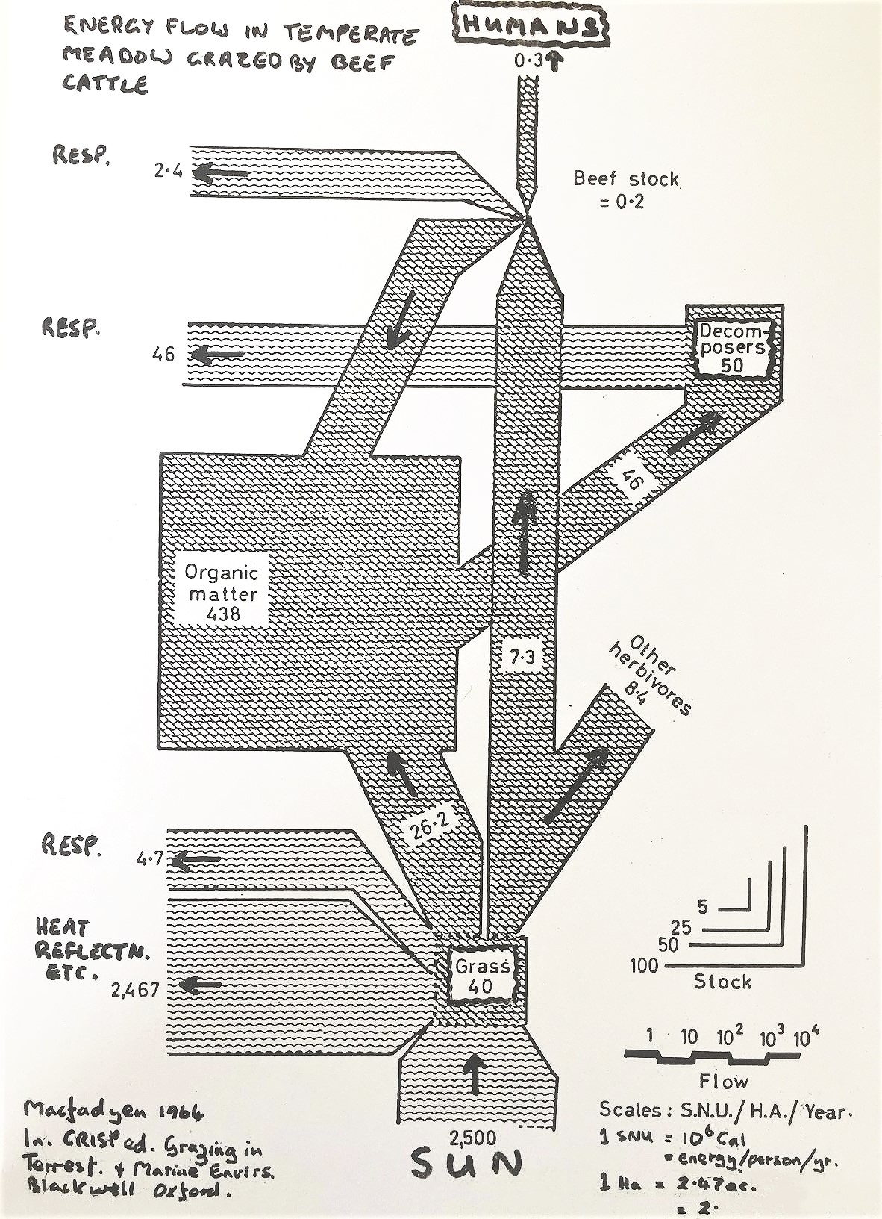

Slide 7

1. Include psycho-social understandings & actions in all initiatives
2. Redesign systems in service of ecologically sustainable & humane values
3. Develop pathways to whole system change from doable, contextually-relevant, individual & collaborative (small meaningful) initiatives
Notes:
7

Slide 8

Sustainable Agriculture – Implementation will require:
major improvements in resource use efficiency,
environmental protection & systems resilience – FAO, 2022
research & innovation, advisory services, investments, digitalisation & new technologies – IUCN, 2020
research & innovation, regenerative practices, training & education, transparency & cross-sector collaboration - EIT Food, 2021
Notes:
8

Slide 9
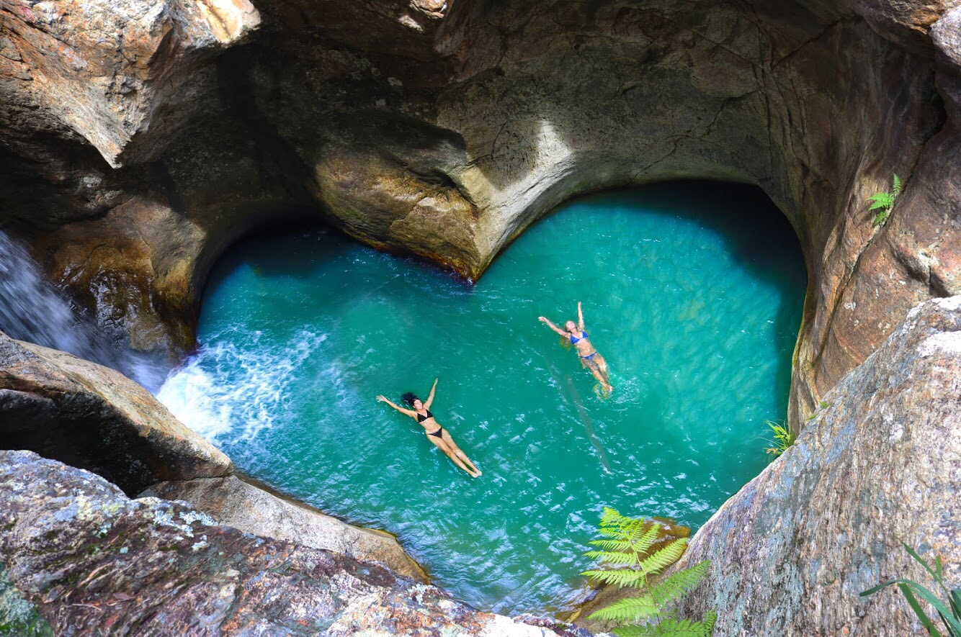
May I have the courage today
To live the life that I would love,
To postpone my dream no longer,
But do at last what I came here for
And waste my heart on fear no more.
John O'Donohue – Benedictus: A Book of Blessings, 2007
At every moment we have the choice of acting on love or acting on fear Lawrence LeShan – talk, 1980s
What is it you plan to do with your one wild and precious life?
Mary Oliver, The Summer Day, 1990
What you are seeking is also seeking you - Rumi, 1207-73
Knowing others is intelligence; Knowing yourself is true wisdom;
Lao Tsu, 604-571 BC

Slide 10
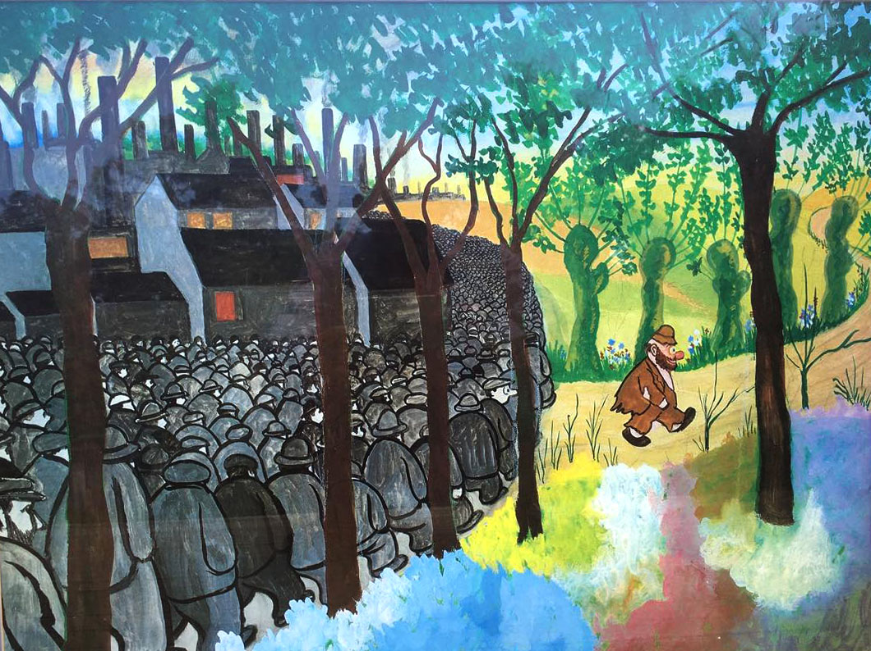
I need: clear values, courage & persistence to continue to clarify & act on my values
Notes:
10

Slide 11
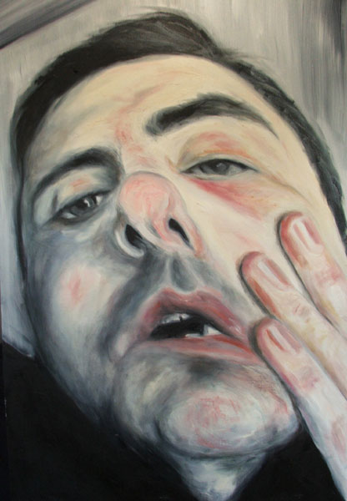
Most of the time we behave as if we
were hypnotised twice
firstly into accepting pseudo-reality as reality, &
secondly into believing we were not hypnotised
RD Laing 1971 The Politics of the Family
Notes:
11

Slide 12


Establishment of compensatory selves
(maladapted & in denial)
hurt, oppression (this has happened to ALL of us!)
adaptation (maladaptation)
core ‘healthy’ self/essence
Core
‘healthy’
spontaneous
in present
aware
empowered
loving
informed action
Maladaptive compensatory
patterned
in past/future
unaware
disempowered
fearful
acting-out/postponing
repeated & new hurts & oppressions
multiple selves
distorted potentially ‘healthy’ behaviour
superimposed ‘unhealthy’ behaviour
Notes:
12

Slide 13
Person (genetics plus)
Understandings, Values, Morals, & Ethics
Past Environments/Experiences
Actions
Present Environment/Conditions
Supportive Oppressive
Notes:
13

Slide 14
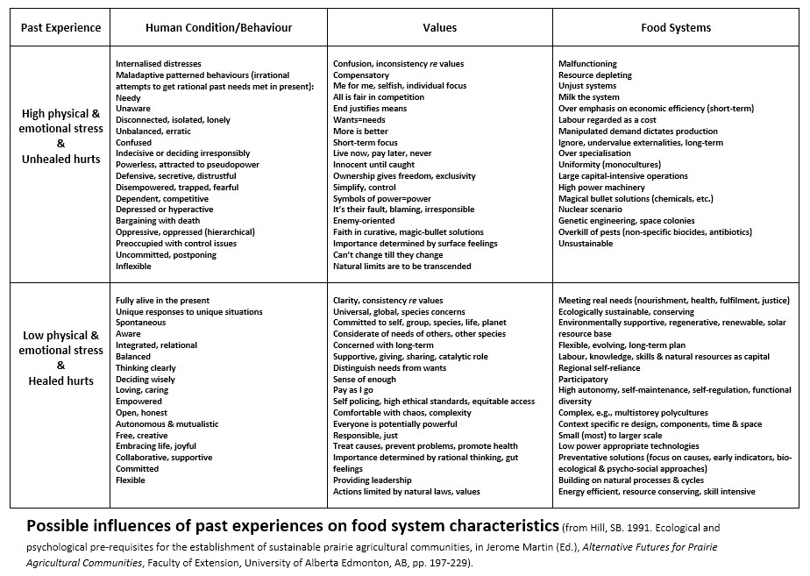

Slide 15
Levels of consideration for effective action
actions
answers,
plans
ideas, imaginings,
visions & creativity
(ability to design/redesign)
psycho-social factors
(& feelings)
worldviews, values & beliefs
Top 2 overemphasised (start from bottom 2)
(modified from John Herron, 1992. Feeling and Personhood. Sage, London)
Notes:
15

Slide 16
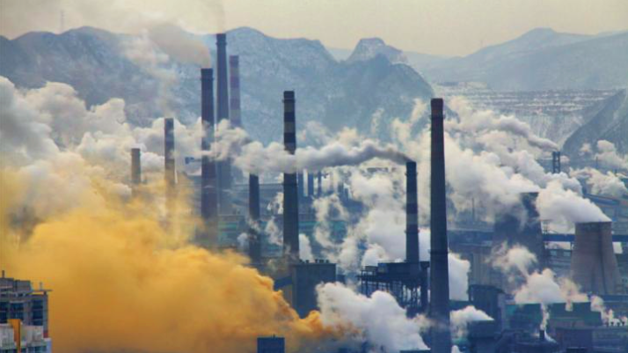
Present main crisis/situation
Degenerative downward spiral; becoming increasingly unsustainable & undermining wellbeing for all present & future generations
(in service of growth, productivity, profit, power, control, advantage, predictability…)
Notes:
16

Slide 17
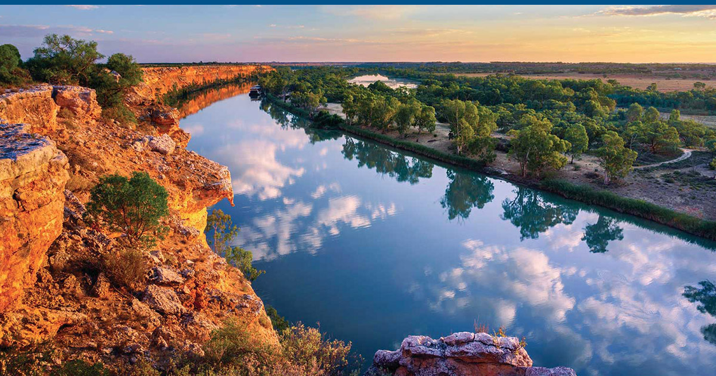
Co-evolving, upward spiral: engaging with cutting-edge areas & ‘unknowns’ (from which we learn our ways forward), & ‘small meaningful actions’
(by which we act our ways forward); becoming increasingly sustainable & supportive of wellbeing for all present & future generations

Slide 18
If any species (including our own) has:
  high numbers
  highly aggregated distribution
  (located away from the resources it needs)
  highly consumptive & non-relational lifestyles
then it will:
  want & consume lots of resources
  have high impacts on the environment & its
  relationships
& so, it will eventually become unsustainable
the time taken to experience this will be shorter the lower
the environment’s ‘carrying capacity’ & ‘resilience’
Notes:
18

Slide 19
If a species has:
  low numbers
  is distributed close to the resources it needs
  has a conserver & responsible / caring / loving relational lifestyle: activities
  lives in an environment with high ‘carrying capacity’ & ‘resilience’, which it builds up & maintains (biodiversity & bio-ecological processes: cycles, etc.)
then it should be able to live sustainably
Notes:
19

Slide 20
Population activities (incl. relationships)
Resource need & use
Environmental impact
Population numbers
Population distribution
Sustainable Unsustainable
Notes:
20

Slide 21
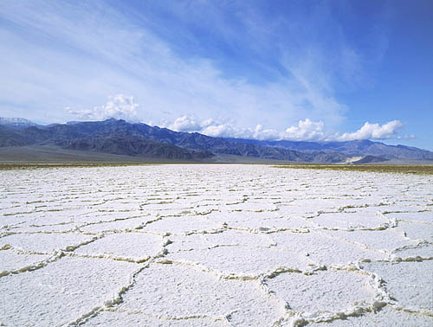
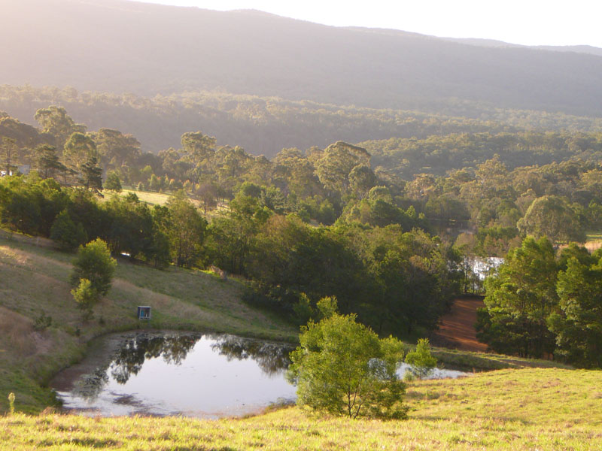
Rewards to natural resource managers, such
as farmers; re maintenance & sustainability
Productivity
yield, output
Erodes natural capital
& ecological integrity
(declining productivity)
Rehabilitation &
maintenance
Builds natural capital,
ecological integrity
(basis for sustained productivity)
Notes:
21

Slide 22
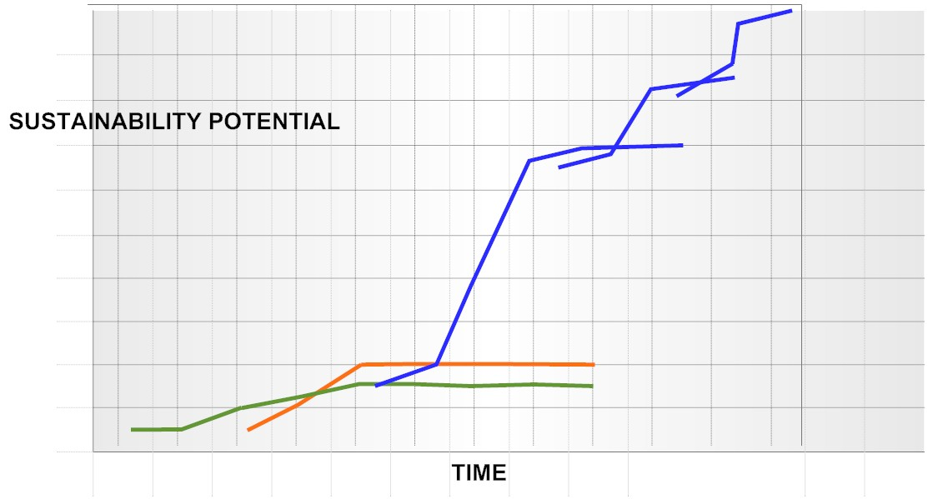
Unrealised potential of design/redesign
etc.
3
2
1
REDESIGN
(proactive)
SUBSTITUTION
EFFICIENCY
(both primarily reactive)
Notes:
22
22

Slide 23
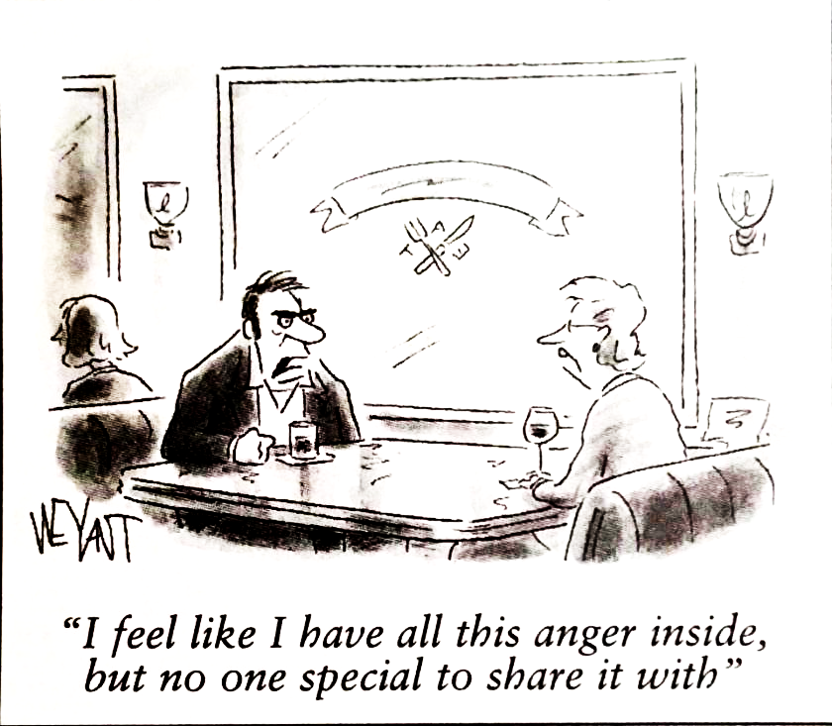

Slide 24
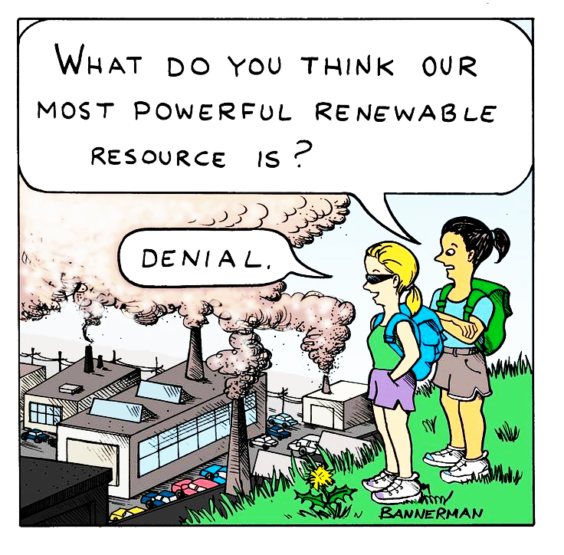

Slide 25
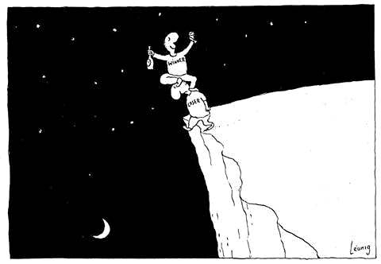

Slide 26
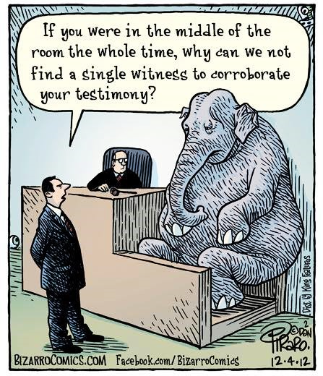

Slide 27

Feedback sensing
Acting
Holistic learning
Creating, designing
& planning
Presencing & engaging
Visioning & imagining
Context sensing
Unknowing & questioning
Provisional knowing
Progressive Spiral

Slide 28
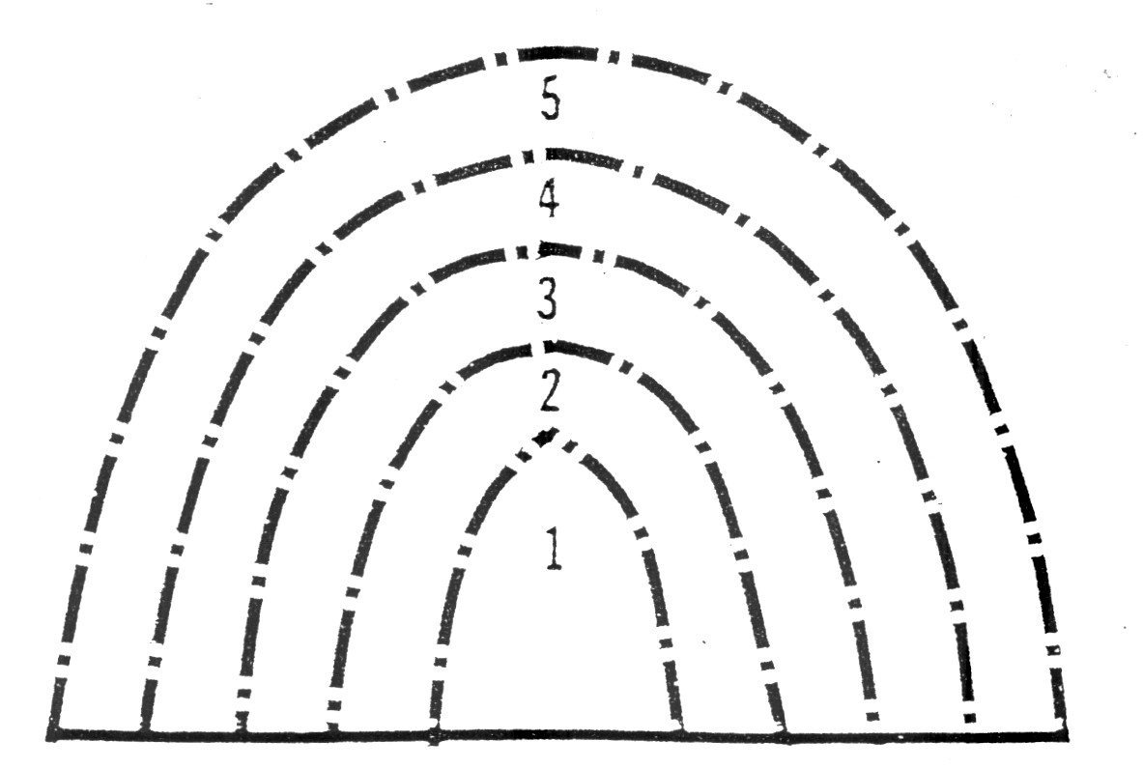
Stages in Understanding (Rachel Lauer’s ‘epistemes’ 1983)
1. initial recognition of thing or concept
2. its definition & measurement
3. understanding its relationships/parallels
4. critical reflection on it (going deeper)
5. recognizing its paradoxical & unknown qualities
(beyond the thing!)
Notes:
28

Slide 29
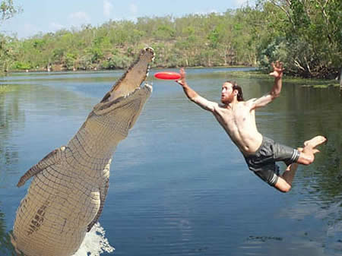
A radical way to progress our thinking & action
is paradoxically (in a workshop context) to boldly ‘LIE'
about changes that you have already brought about
(that you have actually not brought about!)
Enables us to vision & act from our ‘core’ being (our benign potential); not from our maladapted/compensatory selves
By daring to engage in such 'deep' reflection & implementation
of meaningful doable initiatives, we can significantly contribute
to changing our lives & the world for the better
(rather than just tinkering with the status quo)
Notes:
29

Slide 30
Psychosocial evolution & transformative
institutional & structural change (above to below)
Socialising
(fear-based)
Exclusionary
hierarchical
(top down) social
institutions
Problem focus
(reactive)
Enabling
(love-based)
Participatory
social institutions
(co-operacy)
Deep
redesign/design
(proactive)
Notes:
30

Slide 31
Engagement,
Holistic Integration
vs. Observation, Study,
Problem Measurement
Collaborative,
Emergent, Owned,
‘System Redesign’
vs. Curative Imposed
‘Solutions’
Attend
& Respond
to ALL Feedback
vs. Overemphasize $
Ignore or downplay
the rest
Seek
Balance
vs. Control,
Manipulation
Notes:
31

Slide 32


Slide 33


Slide 34


Slide 36
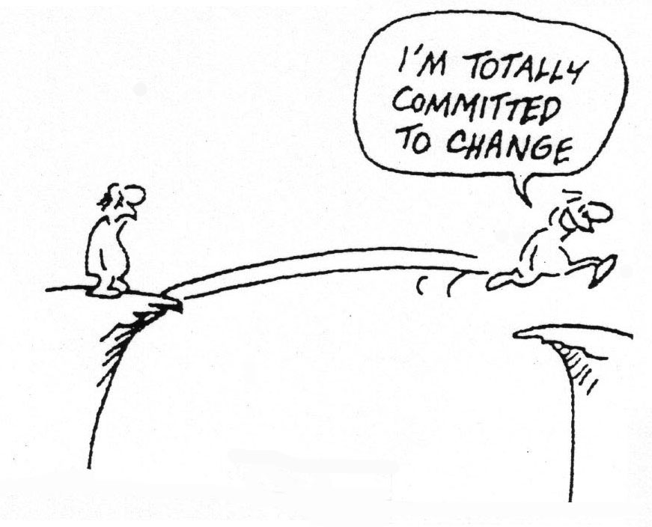
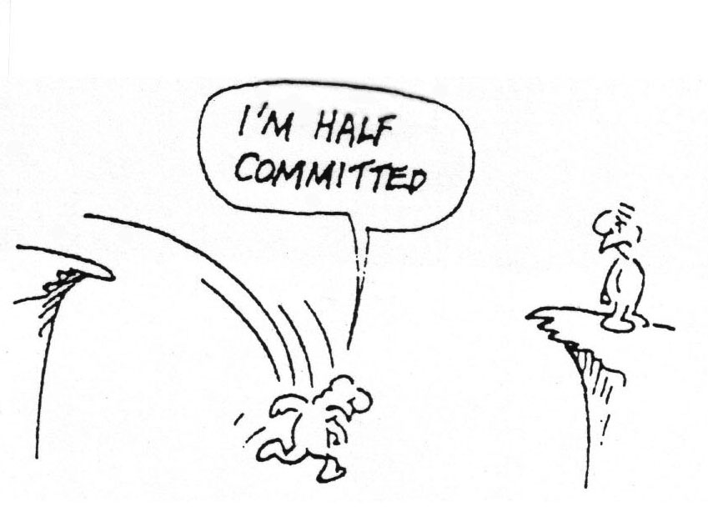

Slide 37
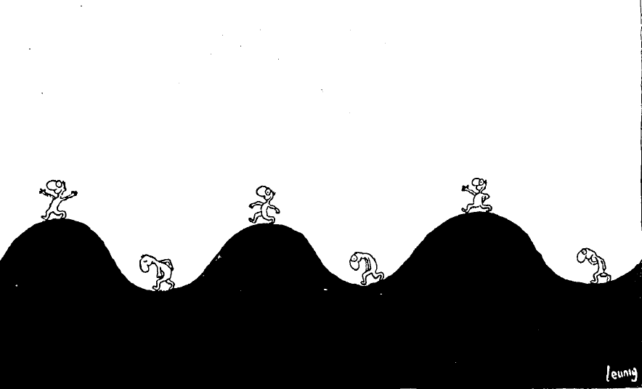

Slide 38
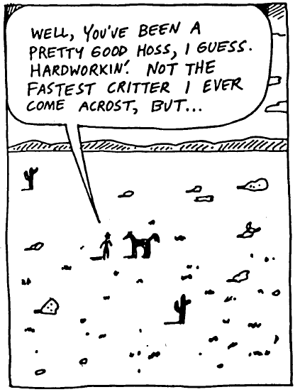
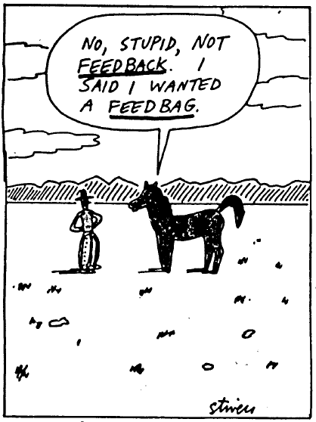

Slide 39
